Slide 1
CSE1142 – Command Line Arguments & File Processing &
Dynamic Memory Allocation in C
Adapted from Dr. Sanem Arslan Yılmaz.
Some of the slides are from: CMPE150 – Boğaziçi University, Deitel & Associates.

Slide 2
Agenda
Command Line Arguments
File Processing
Dynamic Memory Allocation
Examples

Slide 3
Command Line Arguments
Pass arguments to main on DOS or UNIX
  Define main as
      int main( int argc, char *argv[] )
  int argc
    Number of arguments passed (including program name)
  char *argv[]
    Array of strings
    Has names of arguments in order
      argv[ 0 ] is first argument
  Example: $ mycopy input output
    argc: 3
    argv[ 0 ]: "mycopy"
    argv[ 1 ]: "input"
    argv[ 2 ]: "output"

Slide 4
Files
Storage of data in variables and arrays is temporary—such data is lost when a program terminates.
Files are used for permanent retention of data.
Computers store files on secondary storage devices, such as hard drives, CDs, DVDs and flash drives.

Slide 5
Input/Output Files and Text Streams
text file
  a named collection of characters saved in secondary storage
input (output) stream
  continuous stream of character codes representing textual input (or output) data
stdin
  system file pointer for keyboard’s input stream
stdout, stderr
  system file pointers for screen’s output stream

Slide 6
Files and Streams
C views each file as a sequence of bytes
  File ends with the end-of-file marker
    Or, file ends at a specified byte
Stream created when a file is opened
  Provide communication channel between files and programs
  Opening a file returns a pointer to a FILE structure (defined in <stdio.h>) that contains information used to process the file.
  Example file pointers:
    stdin - standard input (keyboard)
    stdout - standard output (screen)
    stderr - standard error (screen)

Slide 7
Creating a File
FILE *cfPtr;
  Creates a FILE pointer called cfPtr
cfPtr = fopen("clients.dat", "w");
  Function fopen returns a FILE pointer to file specifies
  Takes two arguments – file to open and file open mode
  If open fails, NULL returned

Slide 8
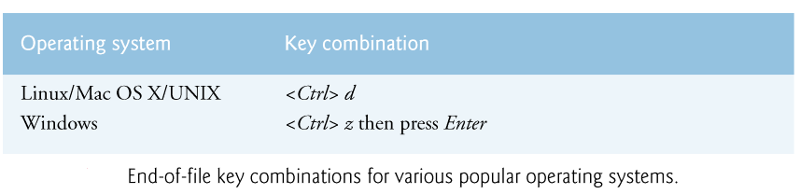
Accessing Files
feof ( FILE *fptr )
  Returns true if end-of-file indicator (no more data to process) is set for the specified file
  The end-of-file indicator informs the program that there’s no more data to be processed.

Slide 9
Accessing Files (cont.)
fclose( FILE *fpt )
  Closes specified file
  Performed automatically when program ends
  Good practice to close files explicitly
Details
  Programs may process no files, one file, or many files
  Each file must have a unique name and should have its own pointer

Slide 10
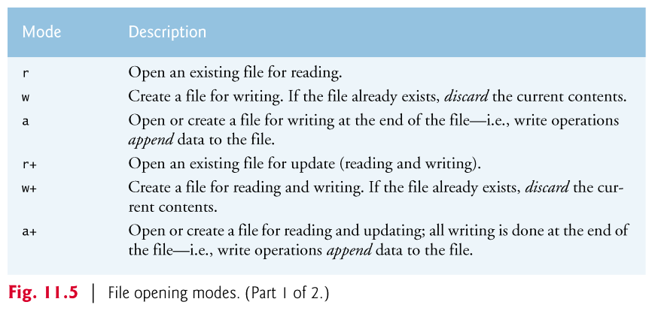
File opening modes

Slide 11
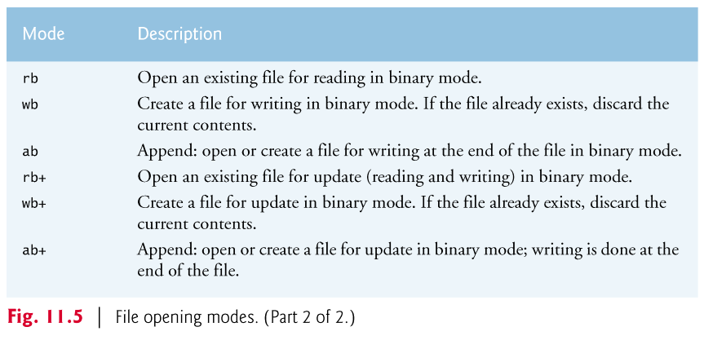
File opening modes (cont.)
binary file: a file containing binary numbers that are the computer’s internal representation of each file component

Slide 12
Read/Write functions in standard library
  int fgetc (FILE *fptr)
    Reads one character from a file
    Takes a FILE pointer as an argument
    fgetc( stdin ) equivalent to getchar()
  int fputc (int char, FILE *fptr)
    Writes one character to a file
    Takes a FILE pointer and a character to write as an argument
    fputc( 'a', stdout ) equivalent to putchar( 'a' )
  char *fgets (char *str, int n, FILE *fptr)
    Reads a line from a file
  int fputs (const char *str, FILE *fptr)
    Writes a line to a file

Slide 13
Read/Write functions in standard library (cont.)
  int fprintf (FILE *fptr, const char *format, ...)
    File processing equivalents of printf
    fprintf(stdout, "%d %s %.2f\n", account, name, balance);
  int fscanf (FILE *fptr, const char *format, ...)
    File processing equivalents of scanf
    fscanf(stdin, "%s %s %s %d", str1, str2, str3, &year);

Slide 14
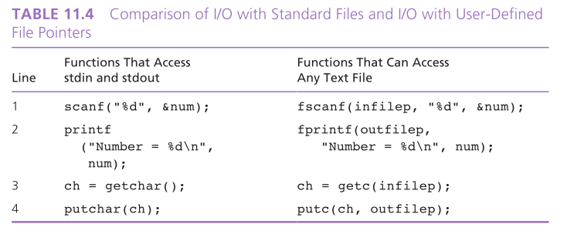
Comparison of I/O functions
Assume that 2 files are opened in the following way:
FILE *infilep, *outfilep;
infilep = fopen("data.txt", "r");
outfilep = fopen("out", "w");

Slide 15
Examples
fileCopy.c
fig11_02.c
fig11_06.c
Notes:
- Explain and run C61_05_fileCopy.c.

Slide 16
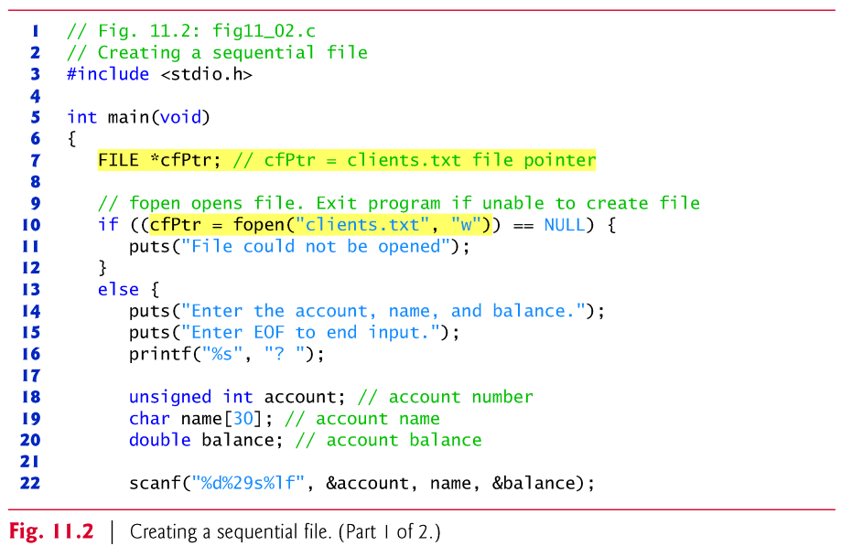
Example: fig11_02.c
Notes:
- Explain and run C61_10_fig11_02.c.

Slide 17
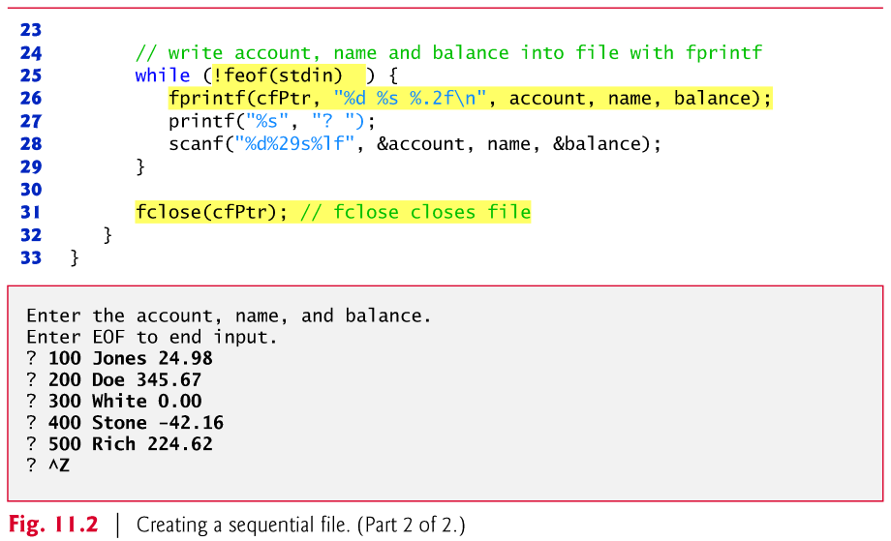
Example: fig11_02.c (cont.)

Slide 18
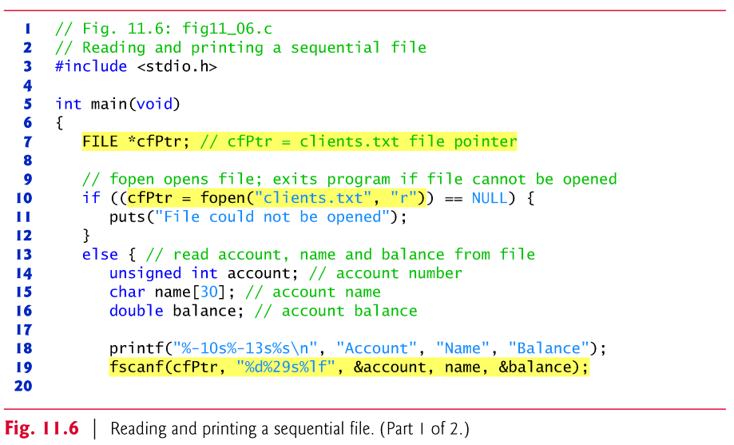
Example: fig11_06.c
Notes:
- Explain and run C61_15_fig11_06.c.

Slide 19
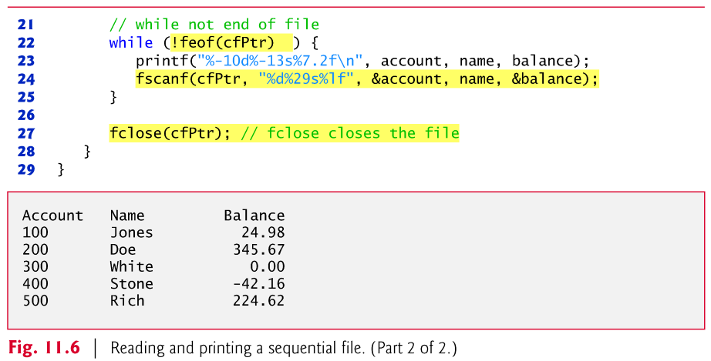
Example: fig11_06.c (cont.)

Slide 20
Dynamic Memory Allocation
Dynamic memory allocation
  Obtain and release memory during execution
malloc
  void * malloc (int size)
  Takes number of bytes to allocate
    Use sizeof to determine the size of an object
  Returns pointer of type void *
    A void * pointer may be assigned to any pointer
    If no memory available, returns NULL
  Example
    newPtr = malloc( sizeof( struct node ) );

Slide 21
Dynamic Memory Allocation (cont.)
Example:
int *nump;
char *letp;
A_t *Ap;
nump = (int *)malloc(sizeof (int));
letp = (char *)malloc(sizeof (char));
Ap = (A_t *)malloc(sizeof (A_t));
*nump = 307;
*letp = 'Q';
Ap->m = 5;
Ap->n = 10;

Slide 22
Example - 1
#include <stdio.h>
#include <stdlib.h>
int main() {
int* ptr;
int n, i;
printf("Enter number of elements: \n");
scanf("%d", &n);
ptr = (int*)malloc(n * sizeof(int));
if (ptr == NULL) {
printf("Memory not allocated.\n");
exit(0);
}
else {
printf("Memory successfully allocated using malloc.\n");
for (i = 0; i < n; ++i) {
ptr[i] = i + 1;
}
printf("The elements of the array are: ");
for (i = 0; i < n; ++i) {
printf("%d, ", ptr[i]);
}
}
return 0;
}
Output:
Enter number of elements:
5
Memory successfully allocated using malloc.
The elements of the array are: 1, 2, 3, 4, 5,

Slide 23
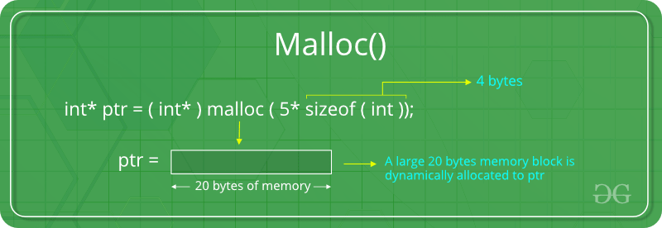
malloc()

Slide 24
Dynamic Memory Allocation
free
  void free (void *ptr)
  Deallocates memory allocated by malloc
  Helps to reduce wastage of memory by freeing it.
  Takes a pointer as an argument
  free (newPtr);

Slide 25
Dynamic Memory Allocation - Arrays
Dynamic memory allocation
  Can create dynamic arrays
calloc
  void * calloc (int nmembers, int size)
  nmembers – number of elements
  size – size of each element
  Returns a pointer to a dynamic array
All malloc/calloc/free functions found in <stdlib.h> header file.

Slide 26
Example - 2
#include <stdio.h>
#include <stdlib.h>
int main() {
int* ptr;
int n, i;
printf("Enter number of elements: \n");
scanf("%d", &n);
ptr = (int*)calloc(n, sizeof(int));
if (ptr == NULL) {
printf("Memory not allocated.\n");
exit(0);
}
else {
printf("Memory successfully allocated using calloc.\n");
for (i = 0; i < n; ++i) {
ptr[i] = i + 1;
}
printf("The elements of the array are: ");
for (i = 0; i < n; ++i) {
printf("%d, ", ptr[i]);
}
}
return 0;
}
Output:
Enter number of elements:
5
Memory successfully allocated using calloc.
The elements of the array are: 1, 2, 3, 4, 5,

Slide 27
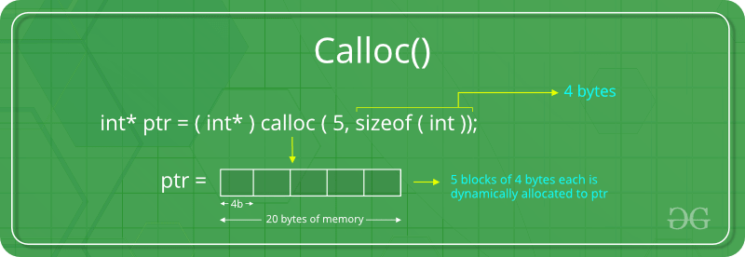
calloc ()

Slide 28
malloc and calloc Return Value
malloc and calloc both return the address of the newly allocated block of memory
  However, they are not guaranteed to succeed!
    Maybe there is no more memory available
  If they fail, they return NULL
  You should always check for NULL when using malloc or calloc.
  E.g.:
    int *arr = (int *)malloc(10 * sizeof(int));
    if (arr == NULL)
    printf("Out of Memory! ");

Slide 29
malloc() vs. calloc()
malloc and calloc both allocate memory
calloc has slightly different syntax
Most importantly:
  calloc() zeros out allocated memory,
  malloc() does not.

Slide 30
Example
#include <stdlib.h>
int *foo(int n){
int i[10];
int *j;
j = (int *) malloc (n*sizeof(int));
// alternatively
// j = (int *) calloc (n, sizeof(int));
return j;
} // i's memory deallocated here; j's not
void bar(){
int *arr = foo(10);
arr[0] = 10;
arr[1] = 20;
// do something with arr
free(arr); //deallocate memory
}

Slide 31
Examples
structExample.c
unionExample.c
Notes:
- Explain and run C61_20_structExample.c.
- Explain and run C61_25_unionExample.c.

